Slide 1

Analysis And Prediction Of Electronic Vehicle Costs A Machine Learning
Based Approach
Presented by:
Kaduru Sri Lekha 22RP1A7229
Varada Mounika 22RP1A7255
Jedula Pravalika 23RP5A7203
Veeramalla Mounika 22RP1A7257
DEPARTMENT OF ARTIFICIAL INTELLIGENCE AND DATA SCIENCE
Under The Esteemed Guidance Of : G. Sudheer Kumar(Assistant professor)

Slide 2
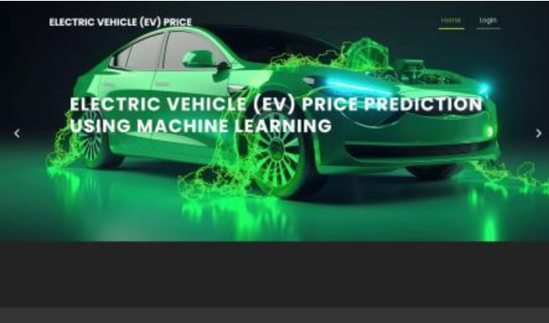

Slide 3
ABSTRACT
Although electric vehicles (EVs) have many benefits for protecting the environment and lowering emissions, their widespread adoption mainly depends on their price. With machine learning (ML) algorithms, costs can be predicted. This research aims to compare the performance of some of the most well-known ML algorithms to determine which algorithm will best predict the price of electric vehicles. To identify the key characteristics, we examined the literature to research the elements that determine the price of electric vehicles in order to estimate their cost. We theoretically compared these ML algorithms to validate our findings and then compared the output of this comparative study to the outcomes of the simulations.

Slide 4
Table of contents
Introduction
Overview
Problem Statement
Objective
Comparison Table of Existing System vs Proposed System
Advantages of proposed system
Tools and Technology
System Implementation
Screenshots
Conclusion

Slide 5
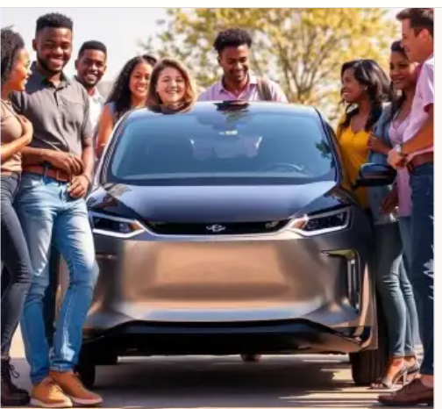
INTRODUCTION
Electric vehicles (EVs) help lower CO₂ emissions and reduce the use of fossil fuels in transportation. Many countries support EVs through government programs, but more action is still needed. Governments should give more help, like money incentives, better charging stations, and support for new technology [1–2].
Cost is a big reason why people choose or avoid electric cars. For many, saving money matters more than helping the environment [3–4].
EVs are still more expensive than regular cars. This is because fewer are made, and parts like batteries and motors are still costly and not produced in large numbers yet.

Slide 6
OVERVIEW
This project focuses on analyzing and predicting the costs of electric vehicles (EVs) using machine learning techniques. By collecting data on factors like battery size, vehicle range, manufacturing scale, raw material prices, and government incentives, we build predictive models to estimate current and future EV prices. The goal is to identify key drivers of cost and forecast when EVs might become as affordable as traditional gas-powered cars. Machine learning algorithms such as linear regression, random forests, and gradient boosting are used to ensure accurate predictions, helping guide decisions for consumers, manufacturers, and policymakers.

Slide 7
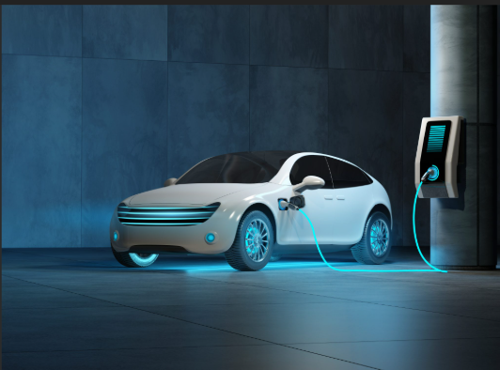
PROBLEM STATEMENT
Electric vehicles (EVs) are good for the environment, but they are still too expensive for many people. The high cost makes it hard for more people to buy them. Things like battery prices, how many EVs are made, and new technology affect the cost. It is hard to know how these things will change in the future. We need a smart way to study and predict EV prices.

Slide 8
PURPOSE
The purpose of this project is to analyze the key technological, economic, and policy factors that influence the cost of electric vehicles and to develop a predictive model that estimates the future prices of EVs with high accuracy. By doing so, the study aims to help consumers make informed buying decisions, enable manufacturers to plan efficient production and pricing strategies, and assist policymakers in creating supportive measures that encourage wider adoption of electric vehicles, ultimately contributing to a more sustainable transportation sector.

Slide 9
Feature | Existing System | Proposed System
Prediction Method | Based on expert opinion or simple trend analysis | Uses machine learning for accurate predictions
Data Usage | Limited data used | Uses large datasets with multiple features (e.g., battery, production)
Accuracy | Less accurate and not reliable | More accurate and improves with more data
Factors Considered | Few factors considered (e.g., only price trends) | Considers many factors like battery cost, model type, technology, etc.
Automation | Mostly manual analysis | Fully automated and data-driven
Future Planning Support | Weak support for future planning | Strong support for decision-making (for buyers, makers, and policymakers)
Technology Used | Basic statistics or manual methods | Advanced machine learning algorithms

Slide 10

OBJECTIVE
To find out what things (like battery size or brand) affect the price of electric cars.
To use machine learning to predict the future cost of EVs.
To understand when EVs might become cheaper and easier for people to buy.
To give helpful information to car makers, buyers, and governments.

Slide 11
ADVANTAGES OF THE PROPOSED SYSTEM
🔍 Accurate Predictions
Machine learning gives better and more reliable EV cost forecasts.
🧠 Smart and Self-Learning
Improves over time as more data is added.
⏱️ Saves Time
Automated system reduces manual work.
📊 Better Decisions
Helps users and policymakers make smart choices with data.

Slide 12
🔧 TOOLS AND TECHNOLOGY
🖥️ Programming Language
Python – widely used for machine learning and data analysis
📦 Libraries & Frameworks
Pandas – for data handling and analysis
NumPy – for numerical operations
Matplotlib / Seaborn – for data visualization
Scikit-learn – for building machine learning models
XGBoost / LightGBM – for advanced, high-performance ML models
🧠 Machine Learning Models
Linear Regression – for simple cost prediction
Random Forest – for handling complex data
XGBoost – for more accurate predictions
💾 Data Sources
EV price data, battery cost data, government reports, etc. (can be from CSV files, APIs, or open datasets)
💻 Development Environment
Jupyter Notebook / Google Colab – for writing and running code
VS Code – as an optional IDE
📊 Visualization Tools
Tableau or Power BI (optional) – for creating dashboards

Slide 13
🛠️ SYSTEM IMPLEMENTATION
1. Data Collection
Collect EV price, battery cost, and production data
Use CSV files, online datasets, or government sources
2. Data Preprocessing
Clean the data (remove missing or incorrect values)
Encode categorical data and scale numerical values
3. Feature Selection
Choose important factors like battery size, model, year, brand
4. Model Selection & Training
Use machine learning models:
Linear Regression
Random Forest
XGBoost
Train models with training data
5. Model Evaluation
Test model performance using metrics like RMSE or R²
Improve model if needed
6. Prediction & Results
Predict future EV costs
Show results using charts and graphs

Slide 14


SCREENSHOTS

Slide 15



Slide 16
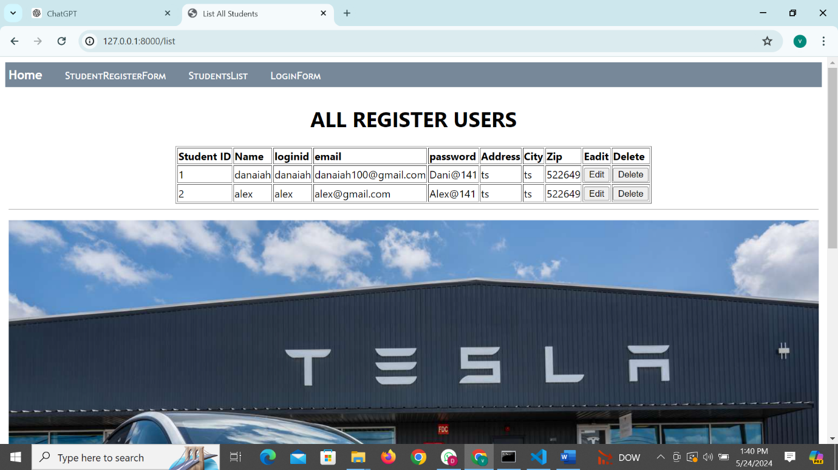

User List:

Slide 17

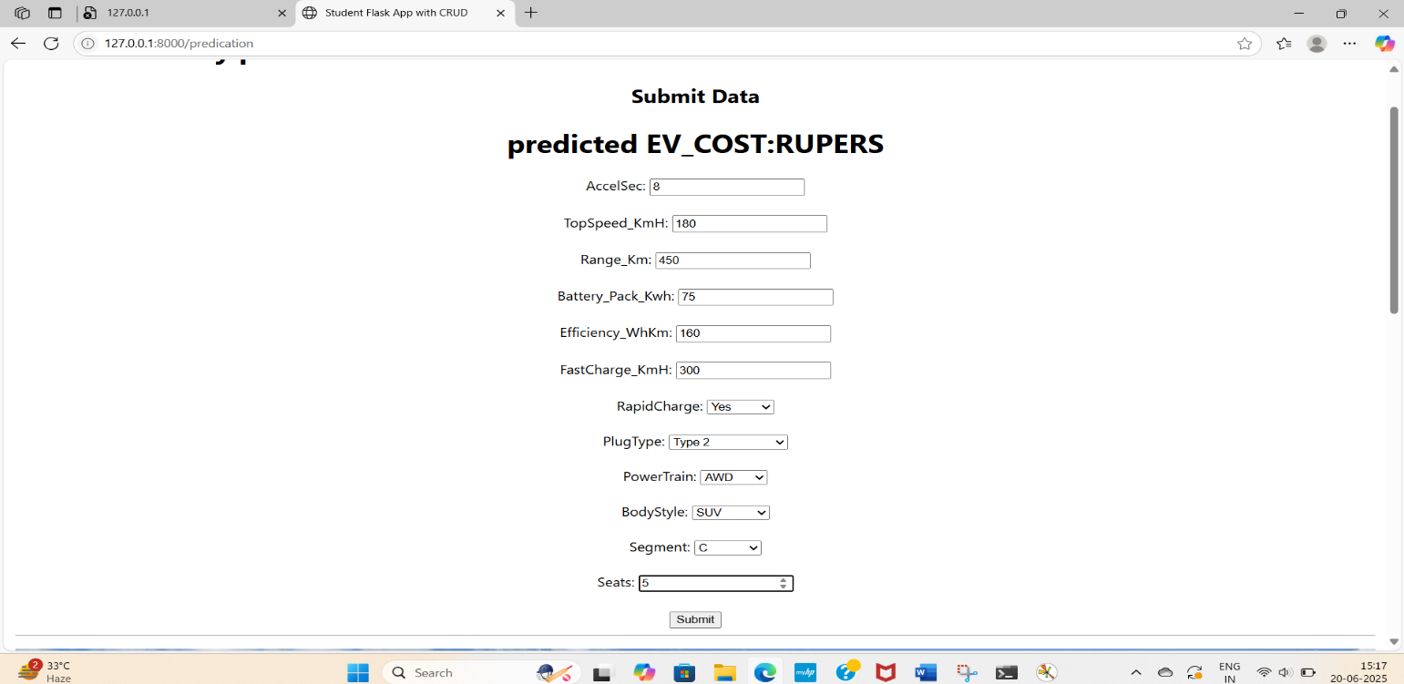

Slide 18
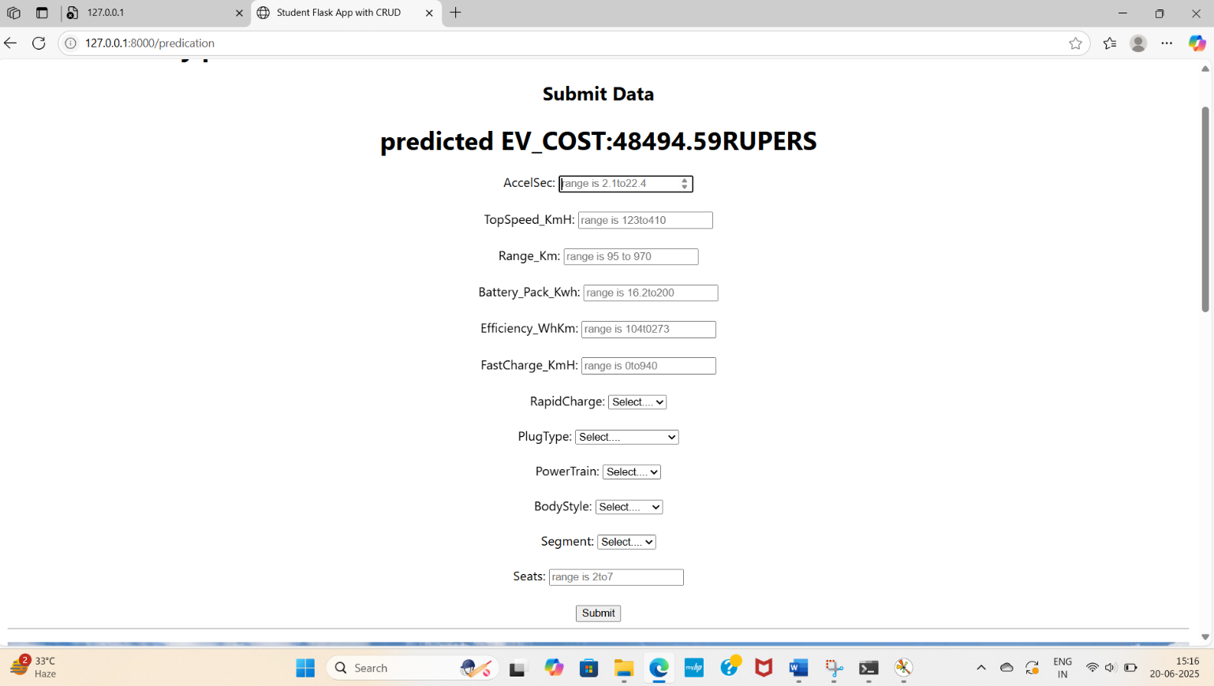

Slide 19
CONCLUSION
Electric vehicle (EV) costs are still high, but machine learning can help predict future price trends.
By analyzing key factors like battery cost and production, we can better understand and forecast EV prices.
This system supports smarter decisions for buyers, manufacturers, and policymakers.
As technology improves and data grows, EVs will become more affordable and widely adopted.

Slide 20


